Slide 1

APRIL 12th
PUBLIC TRAINING SESSION WITH THE EXPLORER FRANCO MICHIELI

Slide 2
Geographer and explorer Franco Michieli showed slides of his nature wandering and exploration across the Alps, the Scandinavian territories, Iceland, and the White Cordillera in South America.
The slide show was accompanied by his readings and reflections about the educational values of walking in nature without the usual technological devices that usually guides people in their travelling. The vice major and the director of our School institution introduced the lecturer to the Pubblic

Slide 3
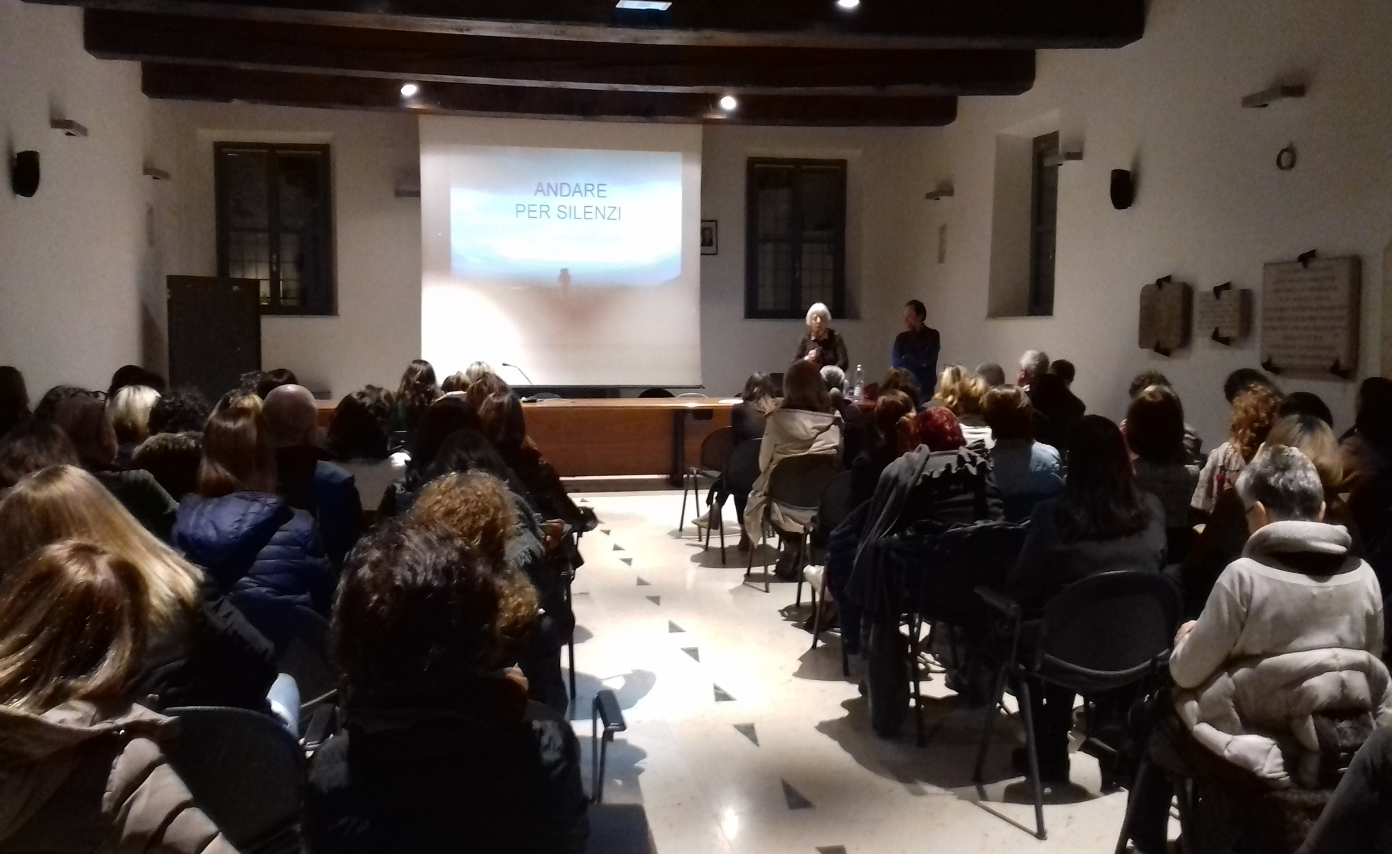
Project Manager Cristina Gaiotto introduces
lecturer Franco Michieli

Slide 4
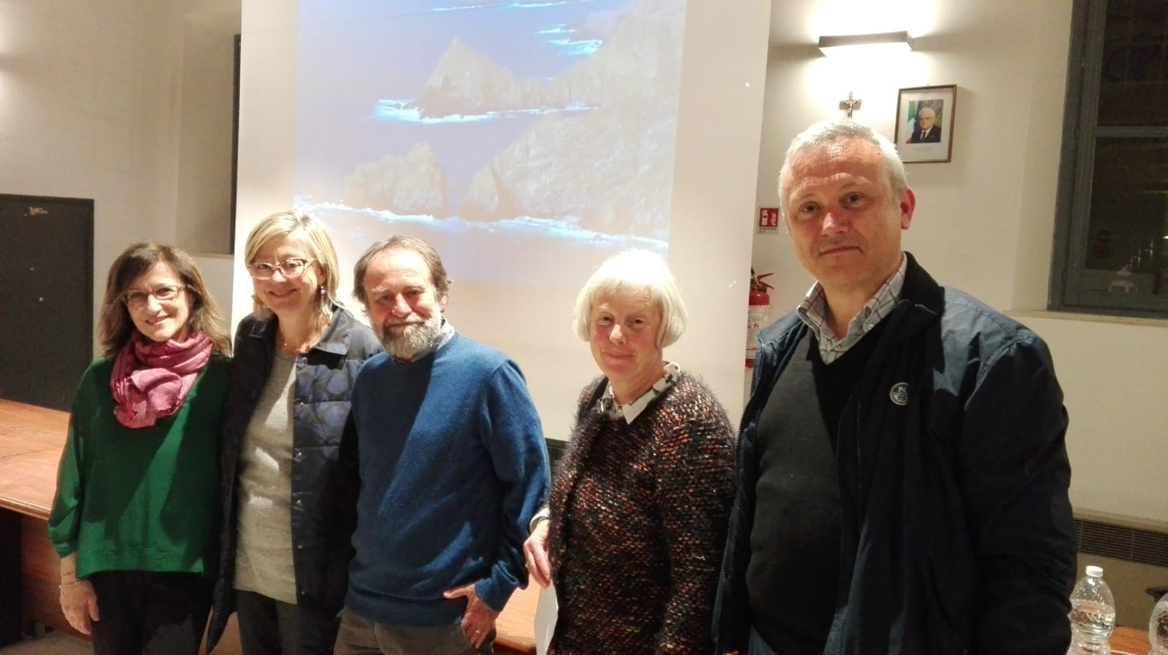
School Director Mg Avallone, Vice Major M. Savigni, Explorer
Franco Michieli President of IC2Nord School Council R Sarto, and
Erasmus Project Manager C. Gaiotto

Slide 5
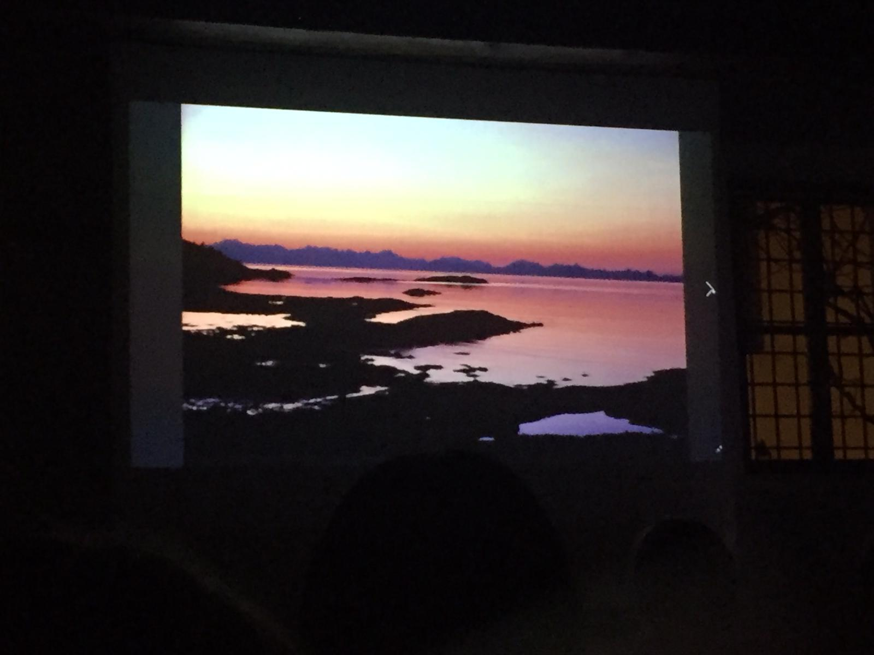
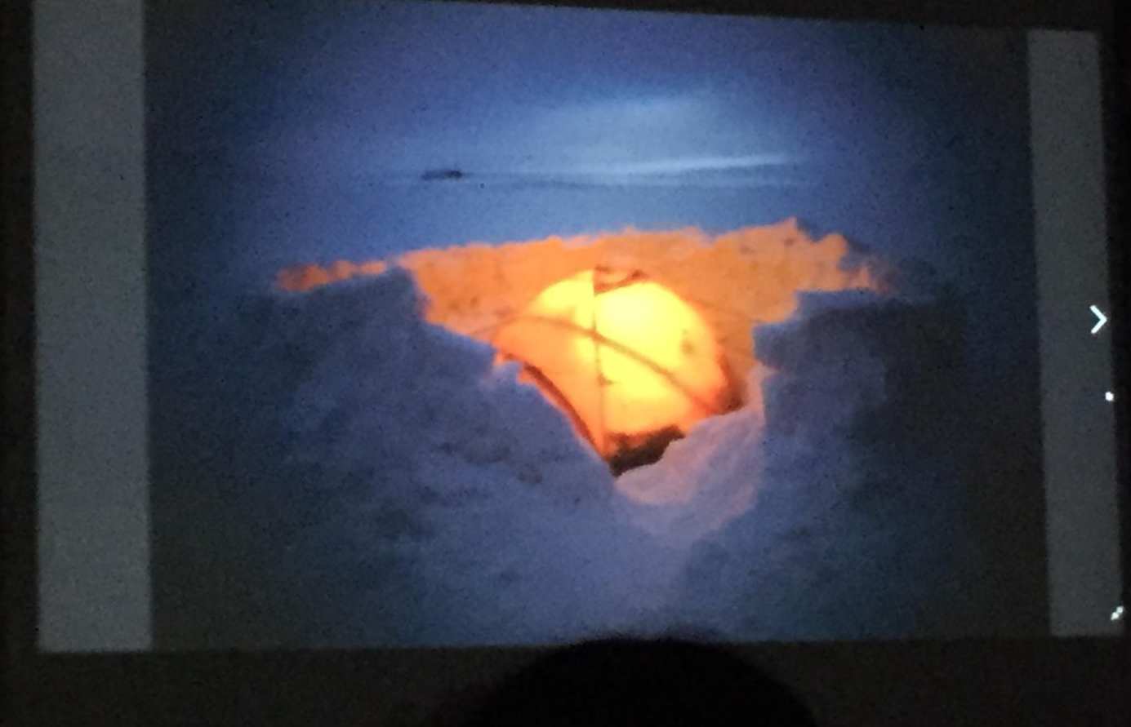
Unforgettable moments
Lost in nature….

Slide 6
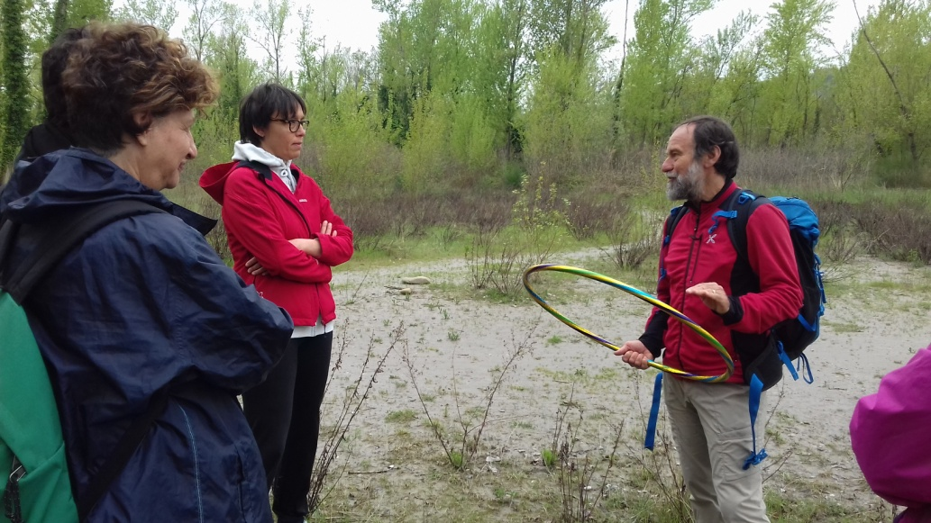
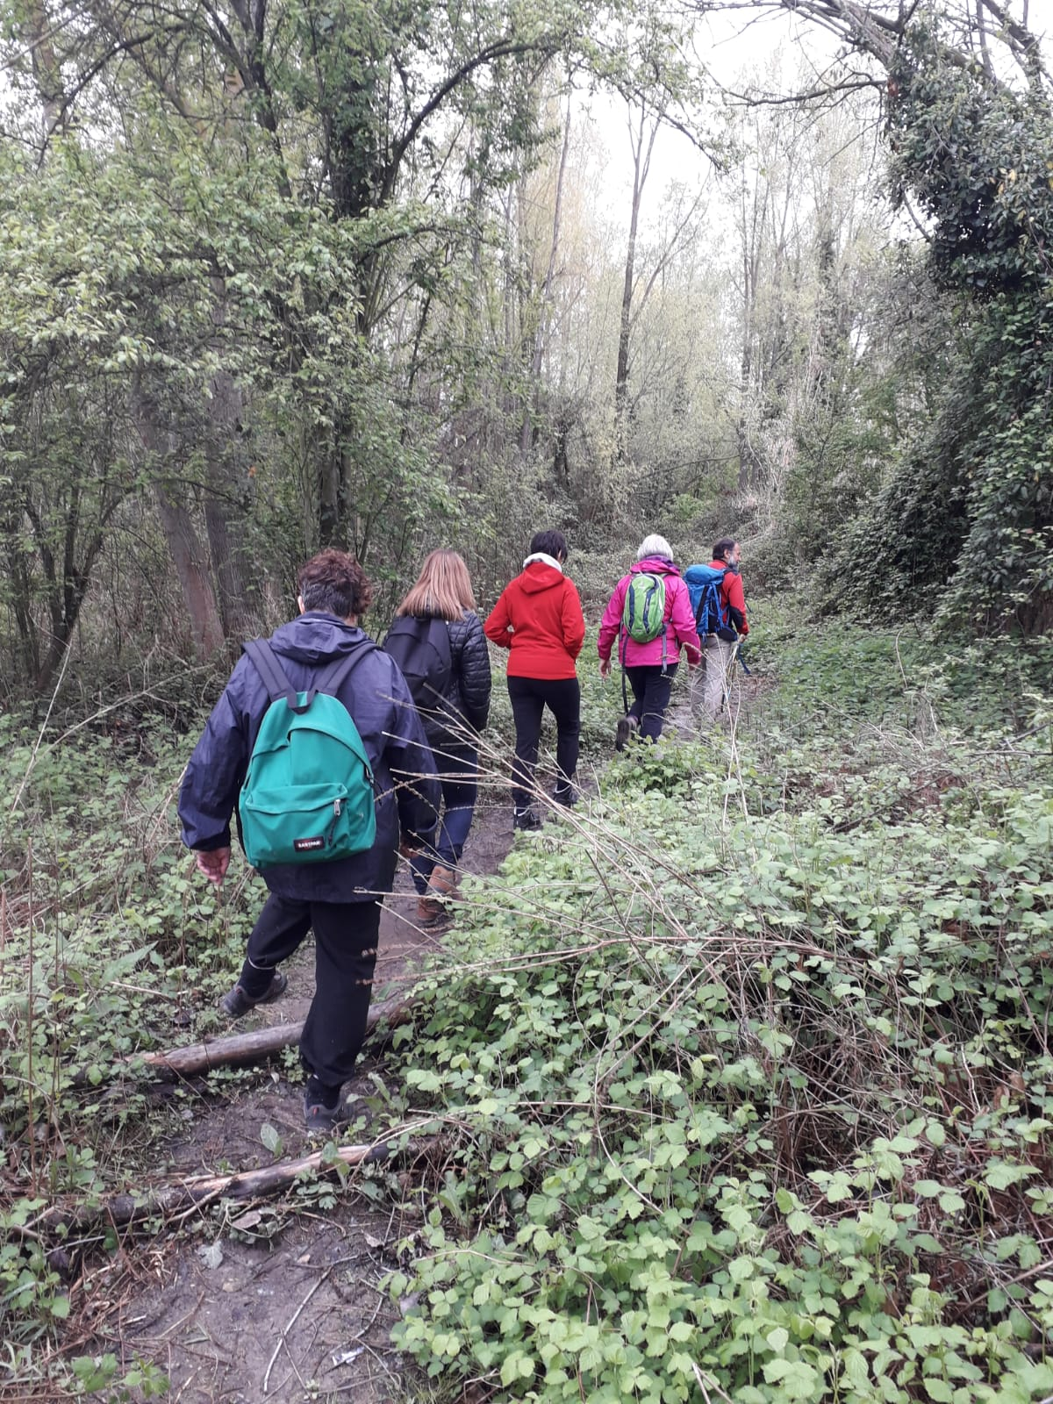
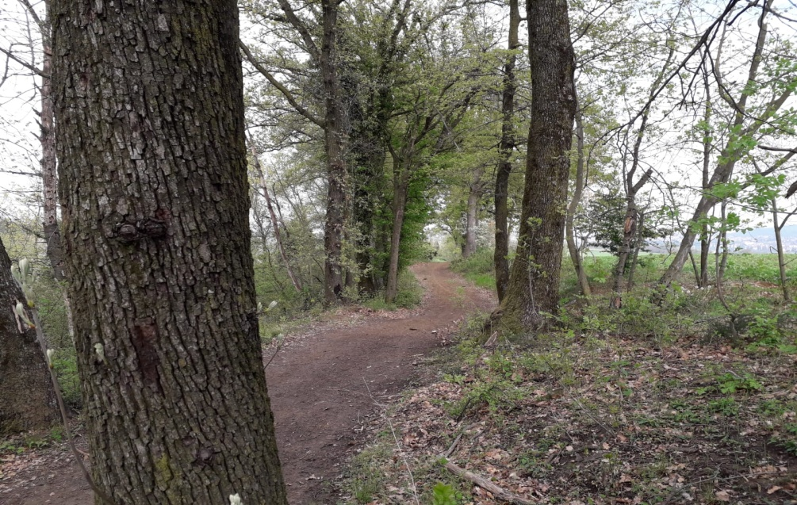
April 13°,2019
Finding our way along river Secchia

Slide 7
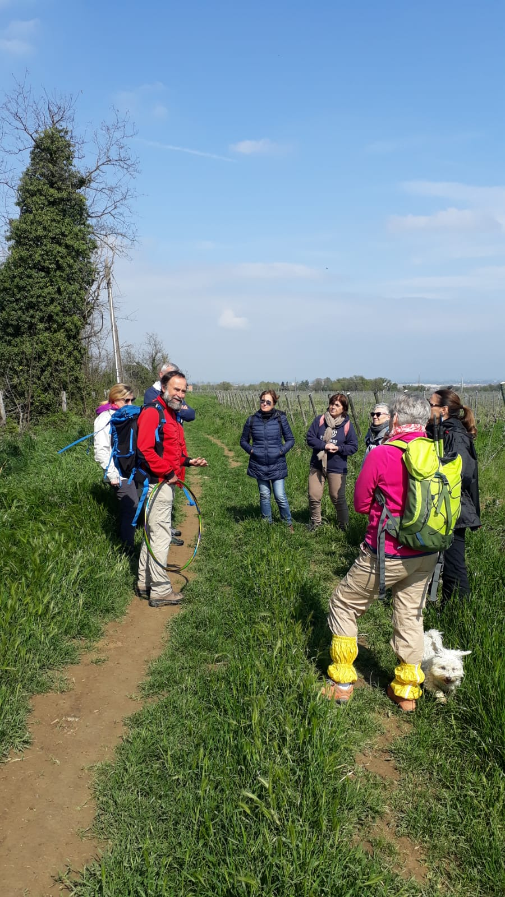
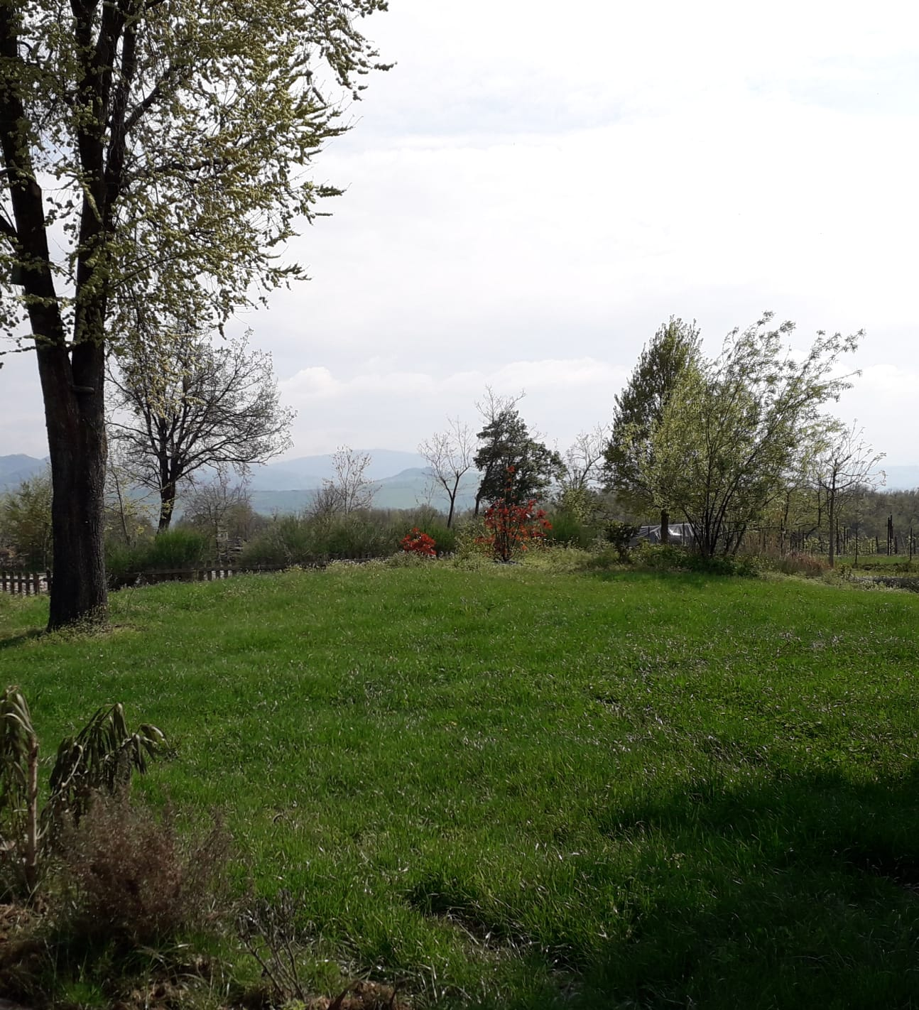
Looking for our path up on the hills

Slide 8
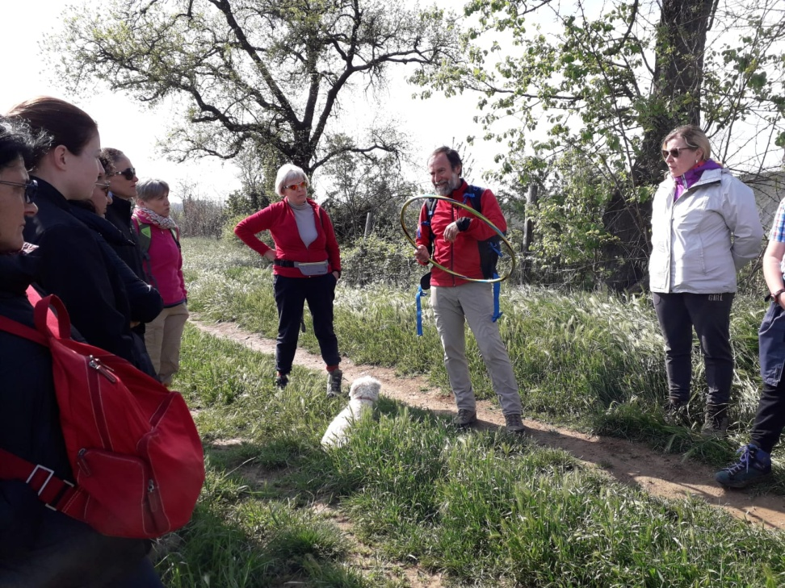
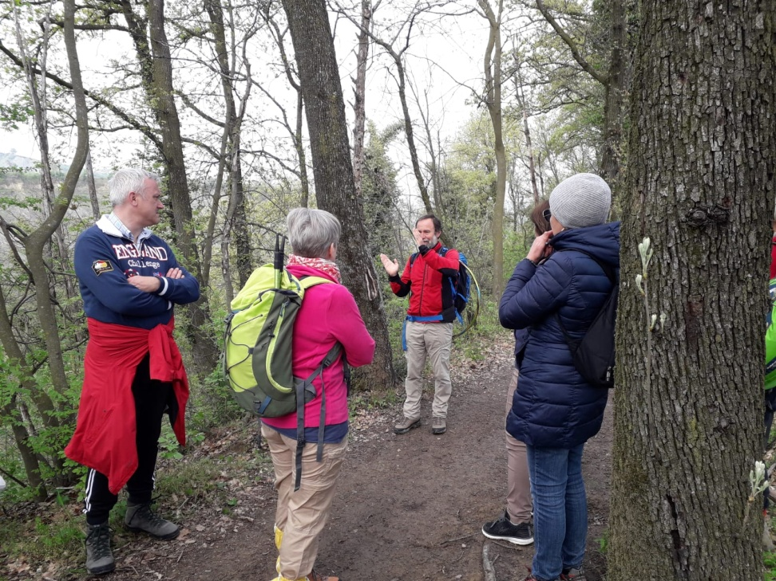
Speaking about the sun the moon and the moss, where is the north?

Slide 9
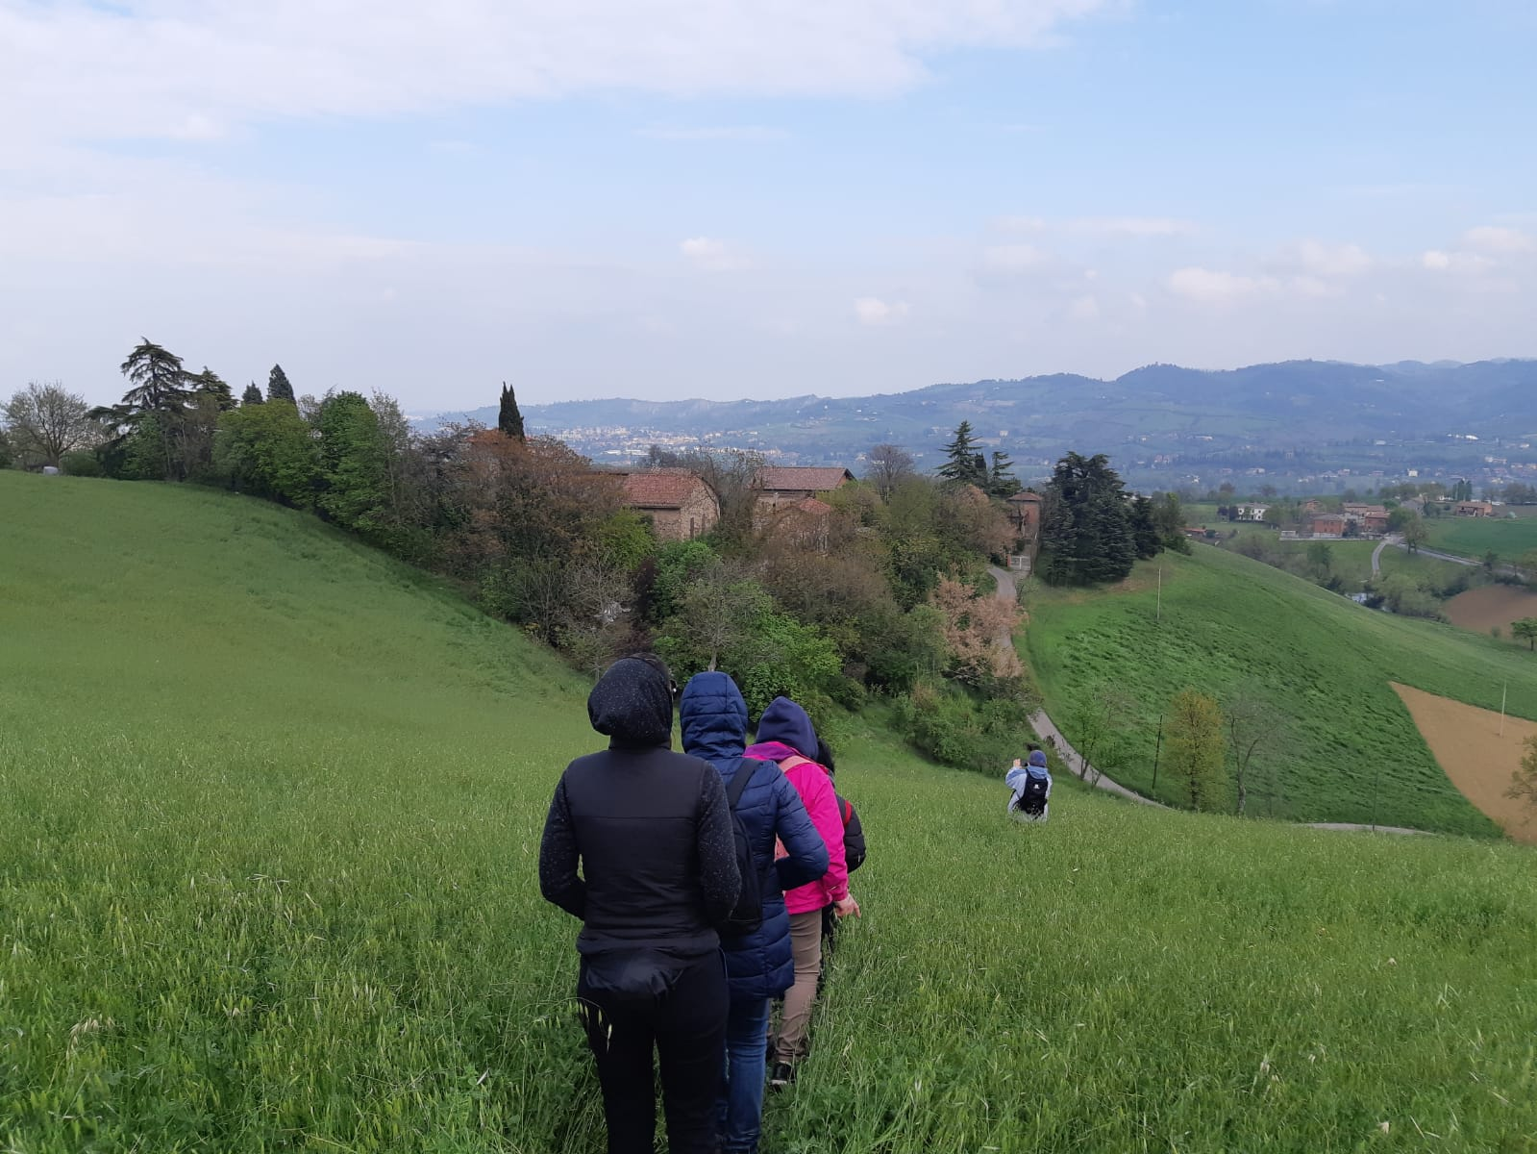
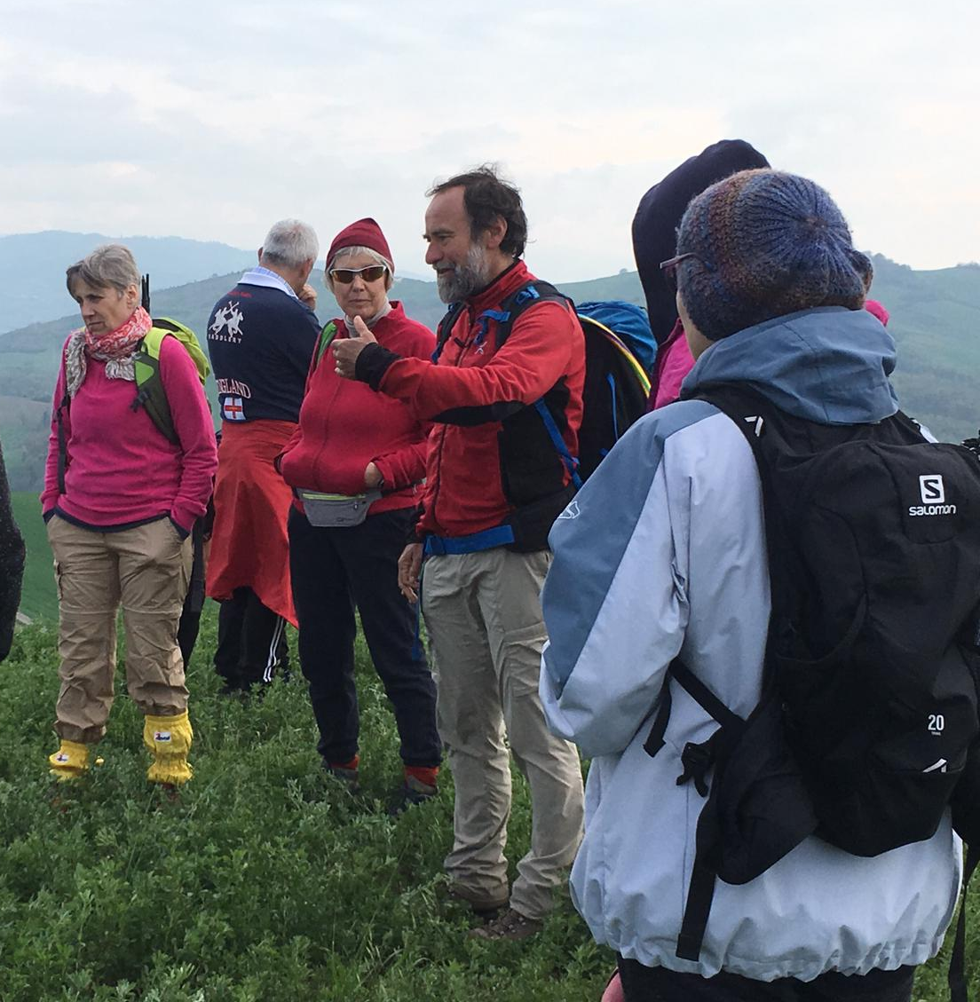

Slide 10
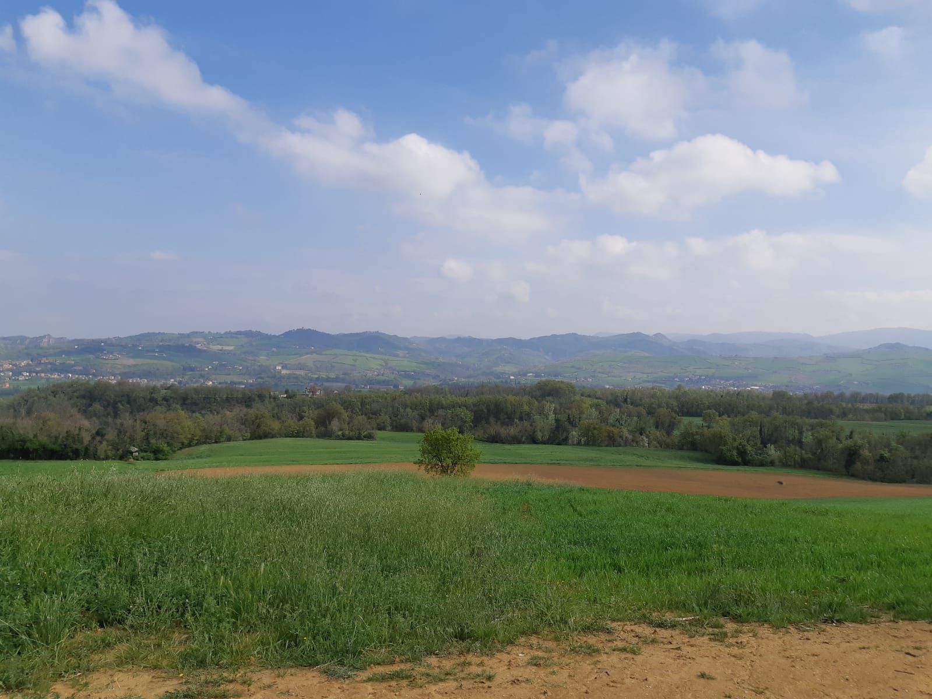
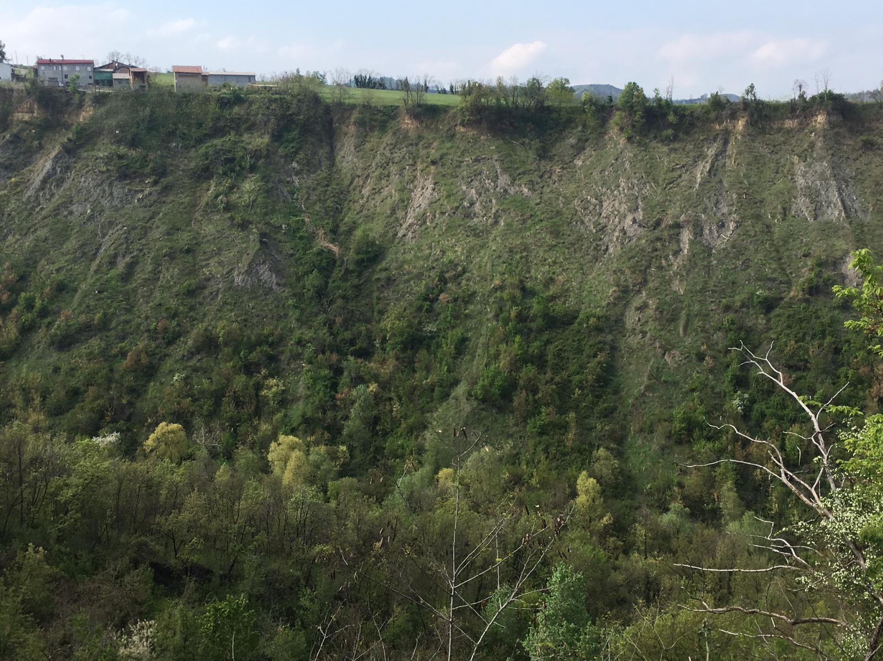
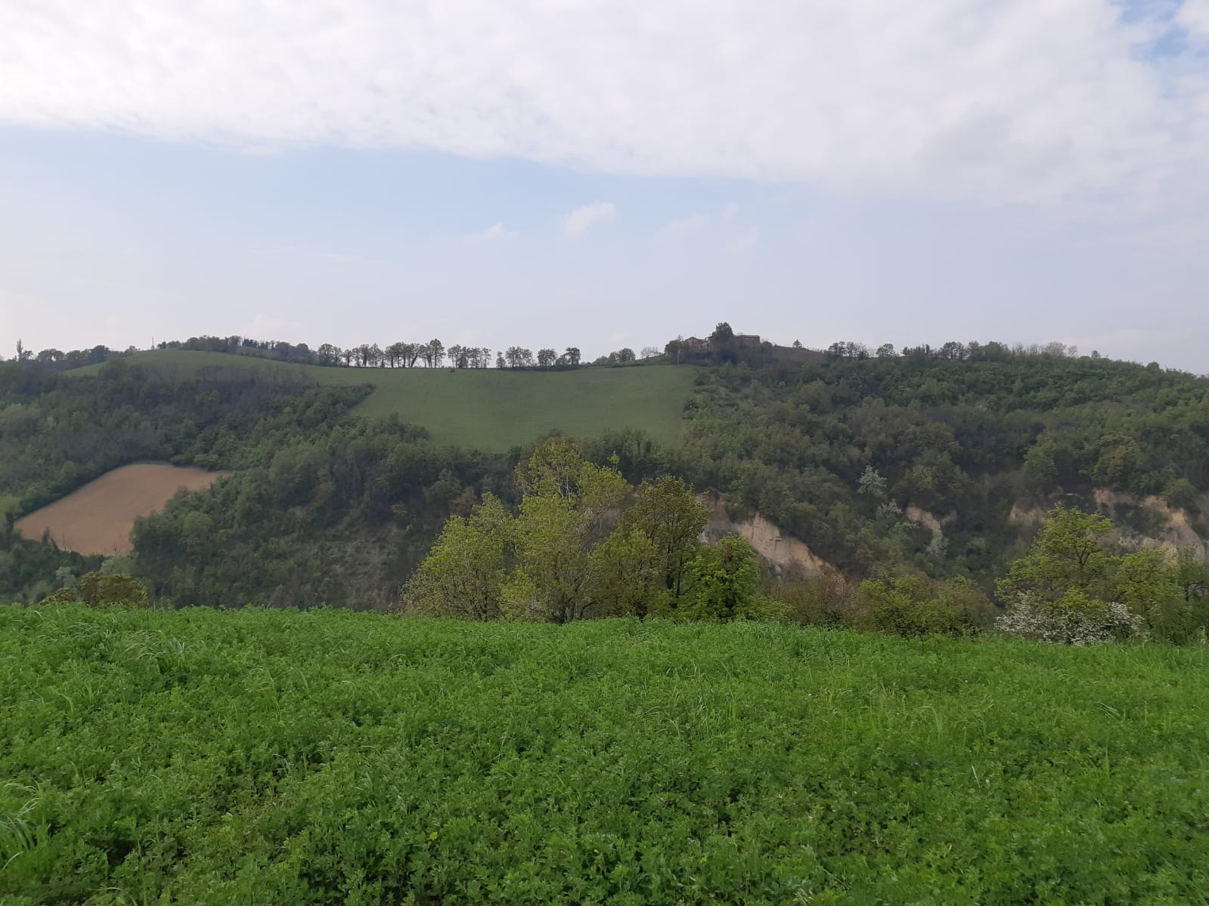
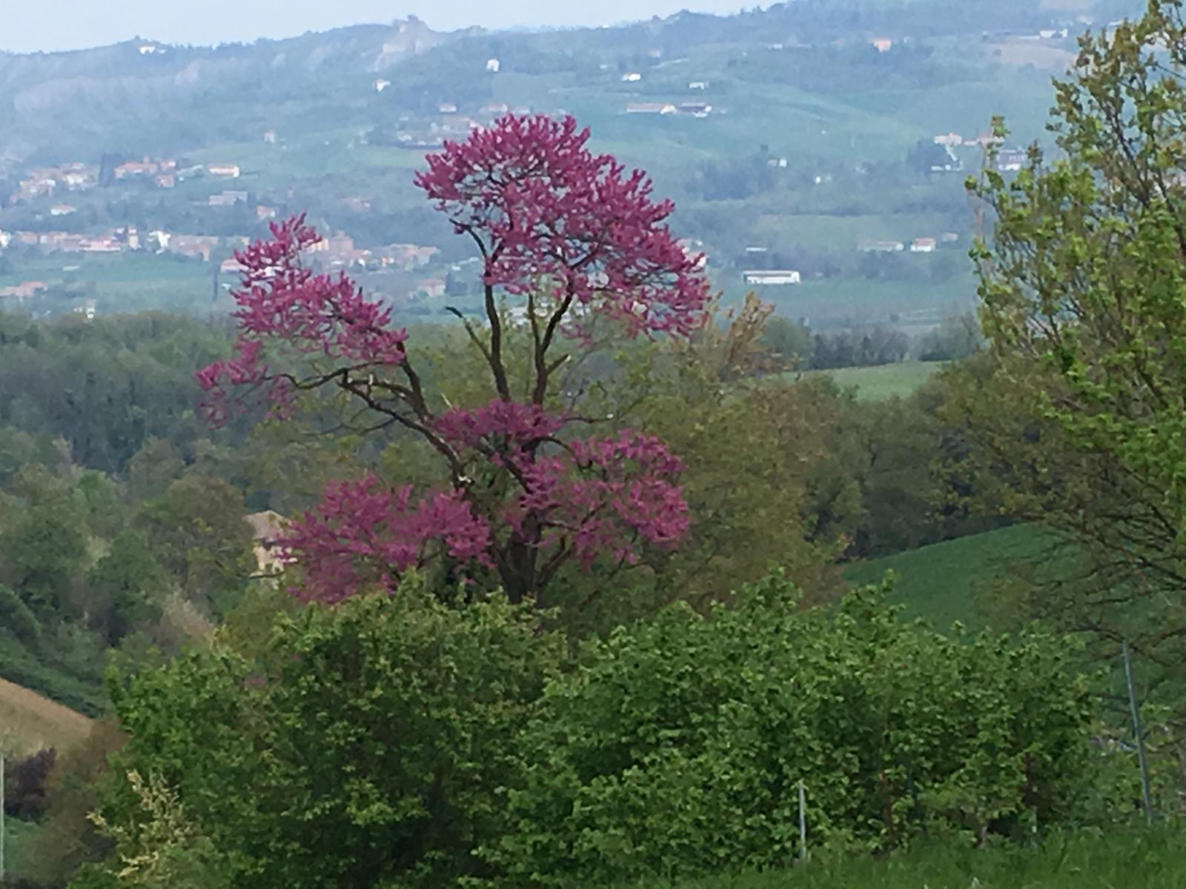

Slide 11
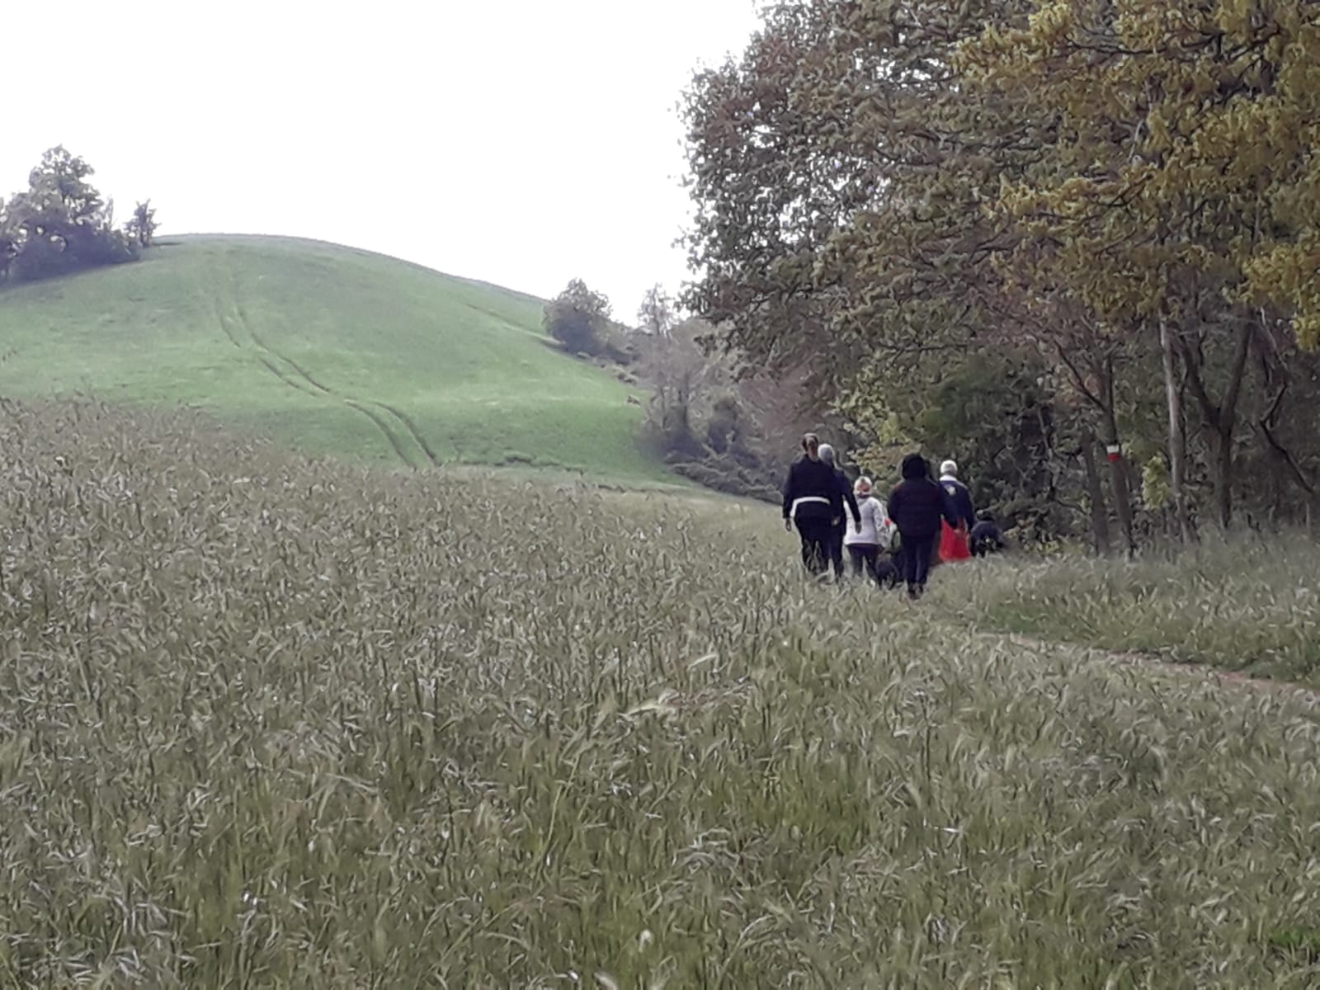

Slide 12
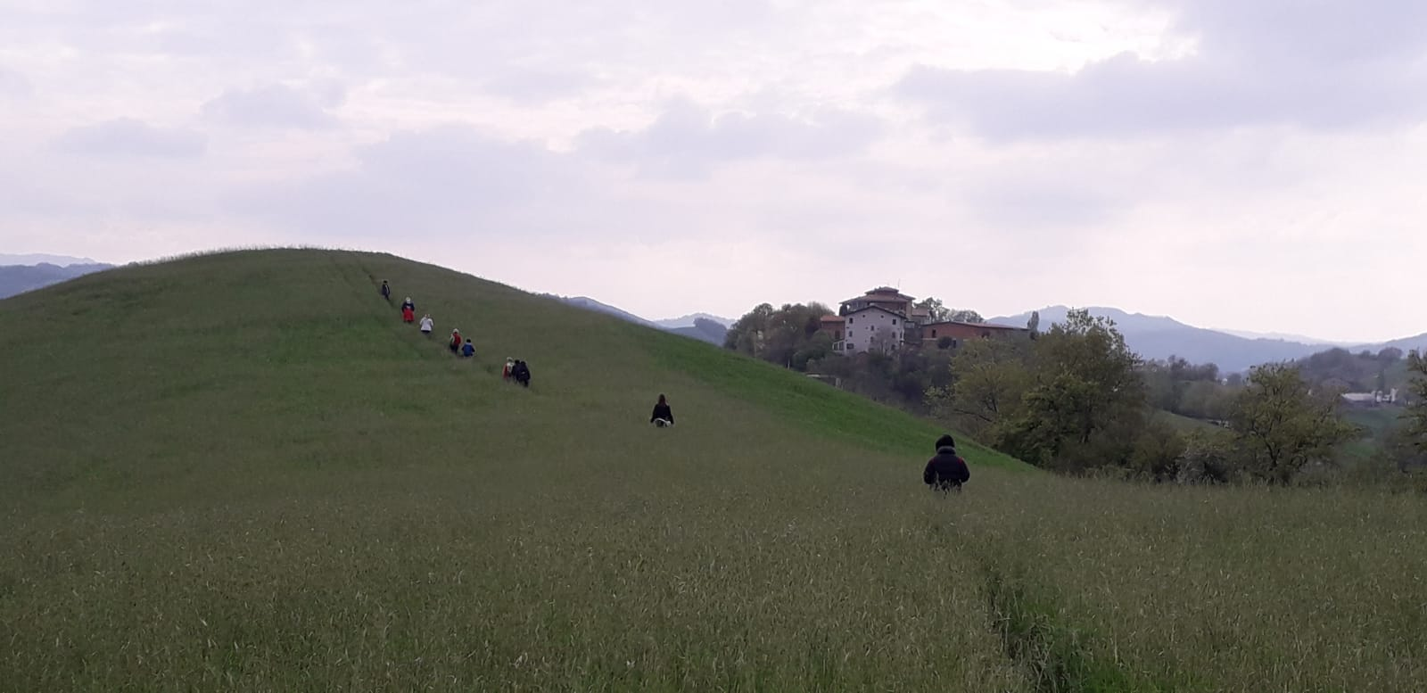
Reaching the top

Slide 13
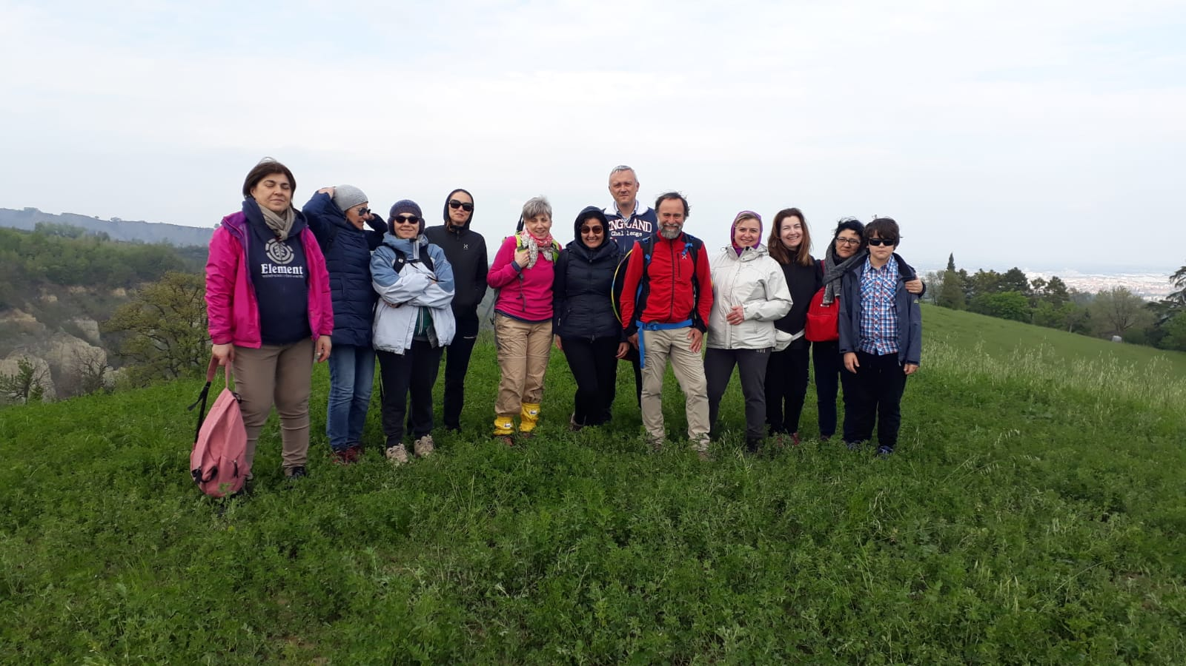
LOOKING FORWARD TO GETTING LOST AGAIN IN NATURE!

